Slide 1
Decomposing Intergenerational Income Elasticity
The gender-differentiated contribution of
capital transmission in rural Philippines
Leah Bevis & Christopher B. Barrett, Cornell University
Econometric Society Australasian Meetings
Sydney
July 2013

Slide 2
Background
Equality of socio-economic opportunity
Often proxied by intergenerational income elasticity (IGE) estimates:
Multiple possible pathways behind IGE and the pathways matter to policy design:
Intergenerational transmission of education
Intergenerational transmission of health
Intergenerational land transfers
Assortative marriage
Migration
Productivity due to correlated unobservables
Yet there has been very limited exploration of multiple possible pathways, esp. in developing countries
2/17
Notes:
IGE: Early estimates biased by measurement error. True estimates around .4-.6, found pretty much worldwide. IGE likely higher in developing world (Salon 2011)

Slide 3
Core questions
How high is IGE/socio-economic mobility in rural Philippines?
Which pathways account for estimated IGE?
Do these pathways vary by child or parent gender?
Does migration affect capital transmission or income transmission?
3/17

Slide 4
Conceptual Model
Per Becker-Tomes model, child adult income results from parental investment in child capital stocks and productivity.
Parental capital stocks may affect child capital stocks in 3 ways:
PC directly transmits to child capital (e.g., health, land)
PC affects parental income, which constrains investment in child capital (e.g., education) given borrowing constraints
PC affects parental preferences and expectations, which affect investment in child capital (e.g., marriage, education)
Also may be intergenerational productivity correlation due to genetics, natural/social environment, unobserved skills, etc.

Slide 5
Conceptual Model
Naïve regression vs. pathway decomposition
Child Income
Income transmission pathways
Child Land
Child /Spouse Education
Child Productivity
Child Health
Capital transmission pathways
Parent Income
Parent Land
Parent Education
Parent Productivity
Parent Health

Slide 6
Estimation Strategy
Estimate naïve IGE, w/ and w/o correction for measurement error in and transitory shocks to parent income (instrument w/initial period parent expenditure). Strategy resolves downward bias due to using short-term income.
Estimate intergenerational capital transmission
where E=education, H=health, L=land, S=spouse education, X=other covariates, ij is child, j is parent. Estimate using 3SLS.
5/17

Slide 7
Estimation Strategy
3) Estimate IGE via OLS-IV using different specifications to isolate pathways of transmission:
i)
Here π captures productivity transmission independent of child capital accumulation. λ_{i} estimates are returns to child capital.
ii)
where μ captures both direct productivity and indirect liquidity effects of parental income. λ are returns to parent capital.
iii)
allows testing of the exclusionary restriction (λ^{p2} = 0) that parental capital has no direct effect beyond that on child capital accumulation and productivity transmission.
5/17

Slide 8
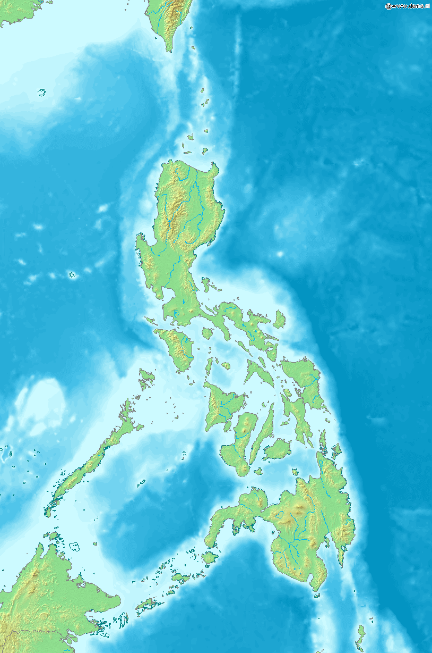
Data
Bukidnon: a rural, landlocked province of southern Philippines
Gathered over two decades:
1984: 448 families relying primarily on agricultural income, largely sugar, corn or rice
2003/2004: revisited original families, tracked children to new homes in local, peri-urban & urban locations
“Split” vs “migrant” children
As children, not significantly different except by gender and birth order.
By adulthood migrants better educated, wealthier
7/17

Slide 9
Data
 | Mean Values Daughters | Mean Values Sons | Mean Values Migrants | Mean Values Non-Migrants
Child Age (years) ‘84 | 9.6 | 10.4 | 9.5 | 10.3
Father Age (years) ‘84 | 40 | 40 | 40 | 40
Mother’s Education (years) ‘84 | 5.9 | 5.6 | 5.9 | 5.6
Father’s Height (years) ’84 | 161 | 161 | 161 | 161
Parent Landholdings (hectares) ‘84 | 2.3 | 2.6 | 2.6 | 2.3
Parent Weekly Income (Philippine Peso) ‘84 | 270 | 301 | 288 | 279
Child Age (years) ‘03 | 29 | 30 | 29 | 29
Child Household Size (persons) ‘03 | ` | 7.2 | 4.6 | 5.3
Child Education (years) ‘03 | 9.7 | 8.6 | 9.8 | 8.8
Spouse Education (years) ‘03 | 9.3 | 10.1 | 10.2 | 9.1
Child Height (cm) ‘03 | 150 | 163 | 155 | 156
Child Landholdings (hectares) ‘03 | 0.1 | 0.3 | 0.2 | 0.2
Child Weekly Income (Philippine Peso) ‘03 | 1830 | 1805 | 2439 | 1326
8/17

Slide 10
Naïve IGE Estimates
Once control for permanent income and life cycle effects, IGE much higher than w/o controls and higher than OECD countries. No stat. sig. difference b/n daughters/sons, migrants/non-migrants
9/17

Slide 11
Capital Transmission Pathways
Key results:
- Liquidity effects limited. Parental income exerts a significant positive effect only on education (esp. sons’).
- Direct intergenerational capital transmission significant. Esp. true for mothers’ human capital on both sons and daughters: children’s education and height, and their spouse’s education.
- Landholdings also pass from parents to children, 4x more
strongly for sons than for daughters. But sharp movement out of agriculture 1984-2004
- Mother’s education negatively related to daughters’ height, seemingly through effect on maternal labor supply and thus on child feeding practices.
9/17

Slide 12
Capital Transmission Pathways
9/17

Slide 13
Income Transmission Pathways
- Naïve IGE estimates statistically insignificantly different between daughters and sons (0.43-0.53).
- But once we control for capital transmission, very different pathways appear by child gender.
- In both cases, landholdings and spouse education strongly affect children’s adult income – and is each strongly associated with parent land and maternal education, respectively. But the estimated marginal effects of landholdings (spouse education) are far higher for daughters (sons).
- For daughters, IGE runs primarily through intergenerational productivity correlation, while for sons no such effect exists.
10/17

Slide 14
Daughters’ Income Transmission Pathways
Very strong intergen-erational productivity transmission effect.
Daughters’ landholdings and spouse education also play a big role.
Some residual effect of maternal human capital.
10/17

Slide 15
Sons’ Income Transmission Pathways
By contrast, no intergen-erational productivity transmission effect.
Sons’ landholdings and spouse education also play a big role.
Some residual (negative?) effect of parental human capital.
10/17

Slide 16
Conclusions
IGE is high (~0.5) in rural Philippines
But there are sharp gender differences in the pathways behind these IGE estimates.
For sons, IGE operates through land and spouse education capital transmission, with some residual (negative!?) association with parental human capital.
For daughters, IGE also operates through land and spouse education capital transmission, but with some residual association with maternal human capital and very strong intergenerational productivity transmission
While parent income does not affect most child capital levels, which are driven primarily by parent capital stocks, son & son-in-law education are normal goods
11/17

Slide 17
Conclusions
Marriage markets and land inheritance are therefore crucial institutions limiting equality of opportunity, especially for women.
Patterns also differ for migrants and non-migrants (not shown due to time), with migrants children’s incomes driven by education, while pathway is landholdings and productivity for non-migrants, potentially signaling the important role of social networks.
Mothers’ human capital is important and transmits relatively equally to sons and daughters. Fathers’ human capital much less important and rarely equal to both sons and daughters.
11/17

Slide 18
Thank you for your time, attention and comments

